Slide 1
The 2023 Financial Crisis Part III
Tom Mack, MBA, A+, Net+
Presenter

Slide 2
Fair Use Notice
The images and videos used in this presentation belong to their respective copyright holders.
These images and videos used in this presentation are used for education, criticism, comment, teaching, and research constituting a Fair Use Exemption under §107 of the United States Copyright Act of 1976.
“Fair Use” is defined as a use permitted by copyright statute that might otherwise be considered infringement.

Slide 3
Disclaimer
The information contained in this presentation is educational material only and is NOT intended to be considered investment advice. Mr. Mack is NOT a registered investment, legal, or tax advisor, or a broker/dealer of securities. All investment/financial opinions expressed by Mr. Mack are from personal research and experience and is intended as educational material only. Although best efforts are made to ensure that all the information contained herein is accurate and up to date, occasionally unintended errors and misprints may occur.

Slide 4
18 U.S. Code §241 - Conspiracy Against Rights
If two or more persons conspire to injure, oppress, threaten, or intimidate any person in any State, Territory, Commonwealth, Possession, or District in the free exercise or enjoyment of any right or privilege secured to him by the Constitution or laws of the United States, or because of his having so exercised the same; or
If two or more persons go in disguise on the highway, or on the premises of another, with intent to prevent or hinder his free exercise or enjoyment of any right or privilege so secured—
They shall be fined under this title or imprisoned not more than ten years, or both; and if death results from the acts committed in violation of this section or if such acts include kidnapping or an attempt to kidnap, aggravated sexual abuse or an attempt to commit aggravated sexual abuse, or an attempt to kill, they shall be fined under this title or imprisoned for any term of years or for life, or both, or may be sentenced to death.
(June 25, 1948, Ch. 645, 62 Stat. 696; Pub. L. 90–284, title I, § 103(a), Apr. 11, 1968, 82 Stat. 75; Pub. L. 100–690, title VII, § 7018(a), (b)(1), Nov. 18, 1988, 102 Stat. 4396; Pub. L. 103–322, title VI, § 60006(a), title XXXII, §§ 320103(a), 320201(a), title XXXIII, § 330016(1)(L), Sept. 13, 1994, 108 Stat. 1970, 2109, 2113, 2147; Pub. L. 104–294, title VI, §§ 604(b)(14)(A), 607(a), Oct. 11, 1996, 110 Stat. 3507, 3511.)

Slide 5
Creation of the Seven Royal Families
And the ten horns out of this kingdom are ten kings that shall arise: and another shall rise after them; and he shall be diverse from the first, and he shall subdue three kings. (Daniel 7:24)
So, he carried me away in the spirit into the wilderness: and I saw a woman sit upon a scarlet-colored beast, full of names of blasphemy, having seven heads and ten horns. (Revelation 17:3)
And the ten horns which thou sawest are ten kings, which have received no kingdom as yet; but receive power as kings one hour with the beast. These have one mind, and shall give their power and strength unto the beast. (Revelation 17:12-13)

Slide 6
Creation of the Seven Royal Families
When Daniel wrote this, none of these royal families existed. They didn’t exist when John Mark wrote Revelation.
The other king that shall arise after them could be the House of Romanov (Russia). They have lots of scores to settle with the European Families and now, China is willing to align with them. China has plenty of scores to settle with the Royal Families as well.
The power of the Beast System comes only when the Seven Royal Families can unify into one family.

Slide 7
The Royal Families Plot to Subject the World
YouTube Link: https://www.youtube.com/watch?v=KGPlr1aoQ78

Slide 8
The Royal Families Plot to Subject the World
YouTube Link: https://www.youtube.com/watch?v=3f4qOEYoBRY

Slide 9
The Thirteen Illuminati Families
The Astor Bloodline
The Bundy Bloodline
The Collins Bloodline
The DuPont Bloodline
The Freeman Bloodline
The Kennedy Bloodline
The Li Bloodline
The Onassis Bloodline
The Rockefeller Bloodline – Banking, Oil
The Russell Bloodline
The van Duyn Bloodline
The Merovingian Bloodline
The Rothchild Bloodline - Banking

Slide 10
Creation of the Seven Royal Families

Slide 11
The Current Royal Families of Europe
The House of Wettin* (Belgium, Poland, et. al.)
The House of Saxe-Coburg-Gotha* (Windsor) (Cadet of the Wettin Line)
House of Bernadotte * (Sweden)
House of Orange * (The Netherlands, England after the Glorious Revolution of 1688, notice the similarities between the founding documents)
House of Oldenburg-Glücksburg* (Holstein, Denmark, Norway)
The Inactive Royal Lines (See next page)
* Indicates active rule.

Slide 12
The Ten Royal Families of Europe
The Inactive Royal Houses – Six Houses – Only Two Will Survive?
House of Hohenzollern (Bavaria-Prussia) The Last German Kaisers (kings) were from this house. (Wilhelm I, Wilhelm II)
House of Hapsburg (Austria)
House of Bourbon/Bonaparte (France, Corsica, Florence)
House of Cronenberg (Germany-Austria)
Two of the Princes and the king in the TV Show Grimm were Cronenbergs though they spelled it Kronenberg. There was one prince that was either a Windsor or a Hanover. (British Accent)
House of Wittelsbach (Northern Germany)
Other Royal Families of Note:
The House of Hanover (once ruled Great Britain, now extinct)
House of Nassau (now extinct)
House of Luxembourg (new extinct)

Slide 13
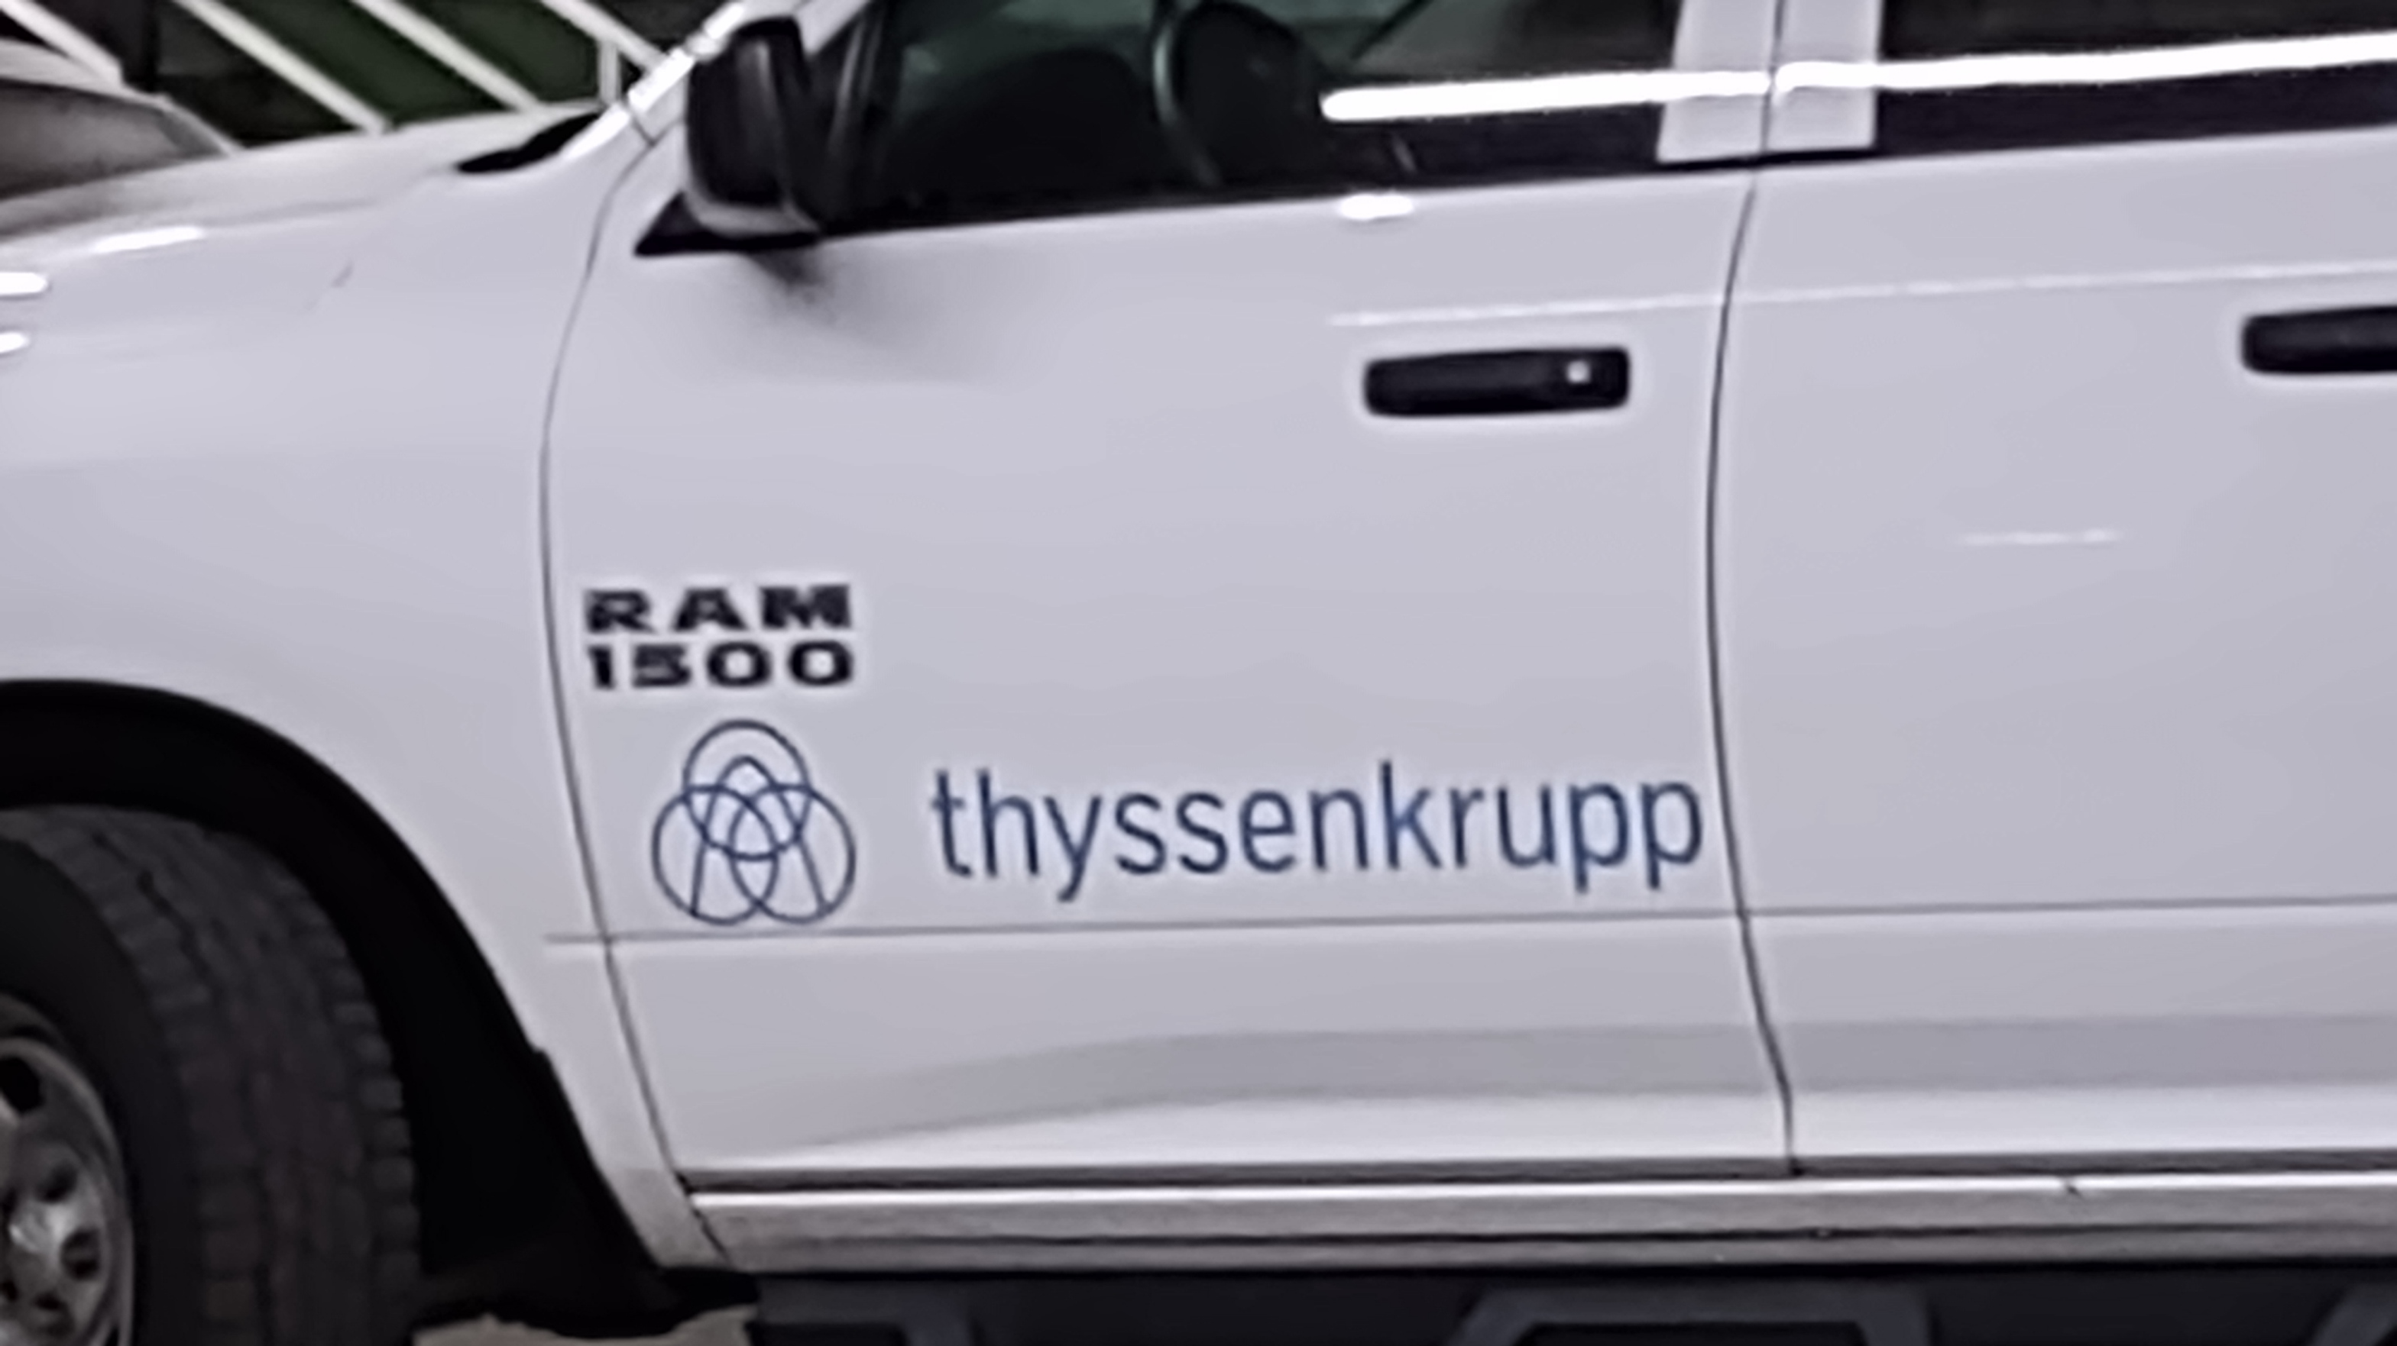
The Bankers’ Results of World War II
World War II was the first time a U.S. Bank was caught financing an enemy. The Union Banking Corporation founded by Prescott Bush. However, the bank was owned by Bank voor Handel en Scheepvaart, N.V., a banking concern from The Netherlands.
This bank had significant connections to the United Steel Works in Nazi Germany. United Steel Works was owned by the Thyssen Brothers.
In the 1990s, United Steel Works merged with Krupp Steel to form the largest steel company in the world. The new company is called ThyssenKrupp AG. They are a huge conglomerate. The truck pictured in the background was photographed in Trinidad, Colorado in 2022.
Apparently, they were there to repair an elevator in the City of Trinidad, Colorado Administrative Offices.

Slide 14
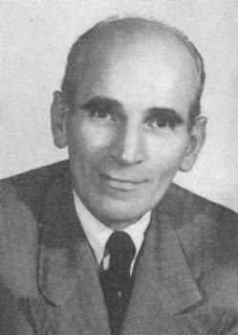
The Bankers’ Results of World War II
Without this convention, Escher Wyss, A.G. would have never survived the War. This company was managed and controlled by Klaus Schwab and his father. They developed turbines that created “heavy water” for the Nazis nuclear program. The company survived until 1969 when it was bought by Sulzer, A.G. When Sulzer bought Escher Wyss, Dr. Schwab still sat on the Board of Directors for a number of years.

Slide 15
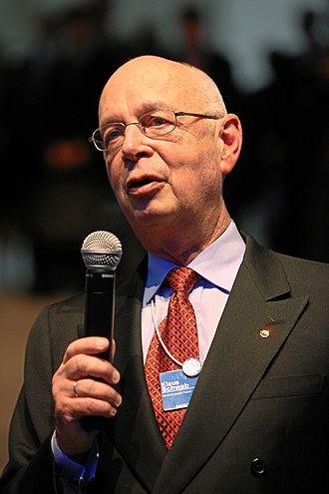
The Bankers’ Results of World War II
Without this convention, Escher Wyss, A.G. would have never survived the War.
This company was managed and controlled by Klaus Schwab and his father.
They developed turbines that created “heavy water” for the Nazis nuclear program.
The company survived until 1969 when Dr. Schwab sold it to Sulzer, A.G. , a now very large conglomerate with locations all over the world.

Slide 16
The Bankers’ Results After World War II
While most European countries were saddled with debts from the War, the United States was convinced, due to the Communist threat, to rebuild Europe via the Marshall Plan.
This gave the United States a reason to occupy West Germany until 1991 when the Berlin Wall was taken down.
Afterward, when Germany was reunited, the U.S. and Germany wrote a new agreement allowing the Luftwaffe (German Air Force) to have bases in the United States while the United States maintains Army and Air Force Bases in Germany.

Slide 17
The Royal Families After World War II
After the War, the sun finally set over the British Empire after three centuries.
Singapore was given its independence.
Their Middle Eastern holdings were given their independence.
India was given its independence… only to break up into India and Pakistan. They have been in a state of Cold War since.
Many of their African holdings also obtained their freedom.
Great Britain did continue to produce and refine petroleum in their former colonies. They also engaged in other business activities. The Bank of England still controls most of these countries… though BRICS is changing that.

Slide 18
The Royal Families After World War II
After the War, the British Empire suffered economically as they tried to rebuild from the War.
Even though the Royal Families lost much influence, they still have their business holdings in trusts holding substantial shares in Royal Dutch Shell and British Petroleum. They have other investments as well.
The British economy tends to follow the United States economy.
The British Pound lost its power to be the medium of exchange.
The 1944 Bretton Woods Agreement gave the U.S. Dollar the role of Primary World Currency.

Slide 19
Banking in the United States
The biggest obstacle for the Rockefeller Family in controlling the banking system of the USA was the lack of Interstate Banking.
The National Bank Act of 1863 forbid interstate banking. That Act was reinforced by the McFadden Act of 1927.
e.g., A Bank in New York could not own a bank in New Jersey.
The Federal Reserve controlled Nationally-Chartered Banks.
Individual state-chartered banks were controlled by the state chartering the bank.
The state banks could opt to buy shares in the Federal Reserve, but none of them ever did. Most state banks did not want anything to do with the Federal Reserve.

Slide 20
Correspondent Banking in the United States
If a state-chartered bank needed funding for a particular loan, they would draw up a “loan package” and take it to their “Correspondent Bank,” a larger bank in a nearby city.
The Correspondent Bank would review the loan and either reject it, finance it themselves (happened about 50% of the time) or farm the offer out to other larger banks in the region.
Banking was decentralized, as the management and Board of Directors of the local bank made the decisions.
Correspondent banks often offered other services as well.

Slide 21
Correspondent Banks in the United States
Correspondent Banks offer services to smaller banks:
Foreign Exchange Transfers
Wire Transfers
Additional Financial Analysis on Loans
Brokerage Services through an affiliated Investment Bank

Slide 22
Correspondent Banking Relationships
Here is a chart of how the banking situation works:
Local Bank (State Bank in Iowa)
Correspondent Bank (Merchants National Bank, Cedar Rapids, Iowa)
Major Investing Banks Major Investing Banks Major Investing Banks
Norwest Bank Bankers’ Trust Company First National Bank-Omaha
Des Moines, Iowa Des Moines, Iowa Omaha, Nebraska

Slide 23
Interstate Banking in the United States
The biggest obstacle for the Rockefeller Family in controlling the U.S. banking system of the USA was the lack of Interstate Banking.
This limitation started to be lifted with the Bank Holding Company Act of 1956 which allowed interstate banking if the states approved it. The Douglass Amendment required “specific state legislative approval.”
Initially, no state followed through with an approval.
Iowa did pass a statute allowing an out-of-state holding company to own a bank in Iowa if there was an existing relationship prior to 1956.
Connecticut and Massachusetts created statutes in 1982 to allow regional holding companies to buy in-state banks.

Slide 24
Interstate Banking in the United States
The biggest obstacle for the Rockefeller Family in controlling the U.S. banking system of the USA was the lack of Interstate Banking.
The Rockefellers lost out in 1985 when the Federal Reserve Board allowed three banking holding corporations to buy local banks in the New England area. Citibank, Union Trust Company, and Northeast Bancorp, Inc., opposed the acquisition.
Notice that Union Trust was owned by the Bush Family and Citibank was controlled by the Rockefeller Family.
They wanted to acquire these banks themselves but do so without having to go through a lot of “red tape” to do so.

Slide 25
Interstate Banking in the United States
The biggest obstacle for the Rockefeller Family in controlling the U.S. banking system of the USA was the lack of Interstate Banking.
The matter would eventually go before the U.S. Supreme Court in Northeast Bancorp, Inc. v. Board of Governors, Federal Reserve System (472 U.S. 159) (1985).
Chief Justice Rehnquist ruled that the Douglas Amendment allowed these banks to make the acquisitions they requested. He rejected all their other arguments as well.
Chief Justice Rehnquist was never a friend of the Rockefellers. Maybe that is one of many reasons why President Nixon nominated him to the court in the first place and why President Reagan renominated him as Chief Justice.

Slide 26
Interstate Banking in the United States
The biggest obstacle for the Rockefeller Family in controlling the U.S. banking system of the USA was the lack of Interstate Banking.
Since the Rockefeller Family was not going to get anywhere with the U.S. Supreme Court, they started lobbying Congress to get what they wanted.
They got their wish when the Riegle-Neal Interstate Banking and Branching Efficiency Act was passed in 1994 and signed into law by President Clinton.
They further got their wish when they got Congress to pass a repeal of the Glass-Steagall Act in 1999. It allowed banks to perform brokerage services and further allowed Investment Banks to engage in banking services.

Slide 27
Interstate Banking in the United States
When the 2007-2008 Banking Crisis happened due to the collapse of the mortgage market, large banks used the opportunity to acquire large brokerage firms:
J.P. Morgan Chase purchases Bear Stearns for pennies on the dollar.
Bank of America purchases Merrill Lynch and Company.
Bank of America purchases Countrywide Financial, a big mortgage company.
Lehman Brothers files for bankruptcy.
American Express, Goldman Sachs and Morgan Stanley convert from Investment Banks to Bank Holding Companies.

Slide 28
Interstate Banking in the United States
The result of this crisis is the creation of banking organizations that are “too big to fail.” Here is a listing:
J.P. Morgan Chase
Citibank
Bank of America
Bank of New York – Mellon Corporation
Goldman Sachs
U.S. Bank
Wells Fargo and Company
If any of these banks fail, it will take down the entire U.S. economy!

Slide 29
Interest Rate Analysis
The Federal Reserve Open Market Committee uses interest rates to manage the national economy.
When the economy is doing well, interest rates are raised to control monetary inflation.
When the economy is in recession, interest rates are lowered to stimulate the national economy.
*Federal Reserve Chairman Paul Volker testifying before Congress in 1981, Courtesy of the New York Times

Slide 30
Interest Rates
Here is a chart outlining the history of interest rates since 1950.

Slide 31
Interest Rates
Here is a chart outlining the history of interest rates since 2018.

Slide 32
Trump Financial Policies
When Donald Trump was elected president, he mandated that interest rates should be raised at slight intervals to control inflation and to reduce financial risks in the marketplace.
A reasonable interest rate discourages risky investments. It also insures that people will get a reasonable return on their savings.
When inflation was deemed to be controlled in 2018, interest rates were lowered.

Slide 33
The 2020 Panic
When it was deemed there was a “Pandemic” in the offing, the Federal Reserve lowered interest rates to zero.
Suddenly, the Venture Capital Companies started investing in business startups that they would not normally consider.
Even Silicon Valley Bank [NASDAQ: SIVB - Trading Halted March 9, 2023] started loaning money to “woke” startups.

Slide 34
The Silicon Valley Bank Debacle
Red Circle Indicates Bank “Run”

Slide 35
Silicon Valley Bank Analysis
During the 2019-2021 Period, the bank received SIX BILLION DOLLARS in new deposits that they needed to invest to offset their “Cost of Capital” requirements.
Remember, all business accounts are paid interest equivalent to the Bank Prime Rate set by the Federal Reserve!
The bank’s management opted to invest in 10-year Treasury Bonds at an interest rate of 1.68%.
Many investment managers would consider this investment sound, were it not for the trend of rising interest rates.

Slide 36
Silicon Valley Bank Analysis
Unfortunately, we have seen that interest rates have risen from the 1-2% they were when they made most of these investments to 4.5% now.
Bank management was not initially concerned because they planned to hold the bonds until they matured in ten years.
However, on their financial statements, due to the “mark to Market” method of accounting (FAS #157), they must show an “unrealized loss” on those treasury bonds and other low interest investments.
One must wonder if the Bank’s management was aware of this accounting rule.
We do know that the Bank did not have a risk manager for several months.
Normally, publicly-traded banks carry insurance to “hedge” against these kinds of risks to their portfolio.

Slide 37
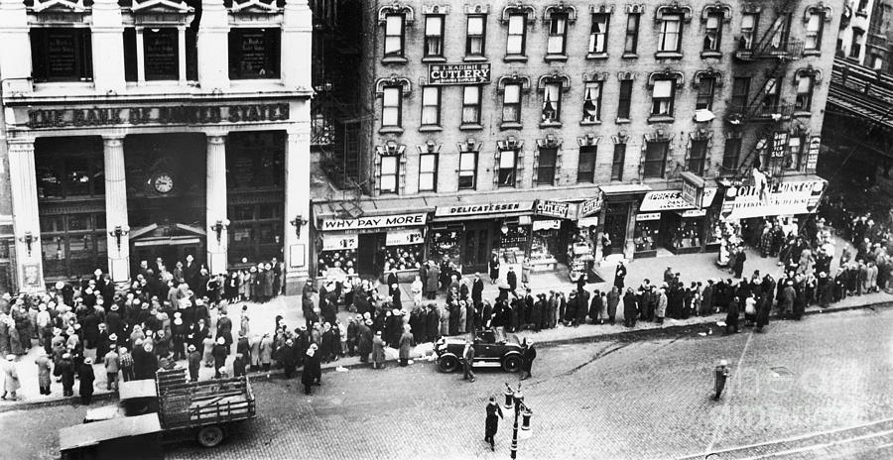
Silicon Valley Bank Analysis
When Moody’s Financial Service discovered these unrealized losses on the bank’s financial statements, they started downgrading the bank’s credit rating.
When financial analysts saw the downgrade of the bank’s credit rating, they advised their clients to move their deposits to a “safer” bank.
This caused a “bank run” but not in the sense we used to see them. This bank run was done with “mouse clicks” on personal computers.

Slide 38
Mark to Market Accounting
Mark to Market Accounting was adopted by the Financial Accounting Standards Board (per Financial Accounting Standard #157) in 1993.
It requires that companies owning “Marketable Securities” update the value of them at the end of their fiscal accounting period.
Let’s look at an example:

Slide 39
Mark to Market Accounting
A company buys 100 shares of XYZ stock for $20 a shares. The entry would be shown as follows:
Investment in XYZ Stock 2,000
Cash 2,000
At the end of the year, the stock is selling for $25.00 a share:
Investment in XYZ Stock 500
Unrealized Gain on XYZ Stock 500

Slide 40
Mark to Market Accounting
However, at the end of the next year, XYZ Stock has gone down to $15.00 a share. The entry would be:
Unrealized Loss on XYZ Stock 1,000
Investment in XYZ Stock 1,000
The final value of the XYZ Stock on the Balance Sheet would be:
Investment in XYZ Stock $ 1,500

Slide 41
Mark to Market Accounting
Traditional accounting used the cost method for valuing assets. That value stayed the same until they day came when the asset was sold. Then, a gain or loss is realized.
Mark to Market Accounting assumes profits when there are not realized.
Mark to Market Accounting assumes all assets with a ready market value are investments.

Slide 42
Thank You
Tom Mack
Email: tom.mack@whitestonefoundation.org
Bible Code Website: https://biblecodes.co
Main Website: https://whitestonefoundation.org

